Slide 1
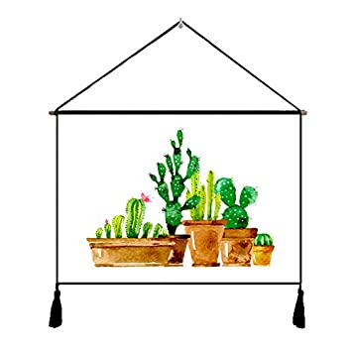
Cocorog piano*

Slide 2
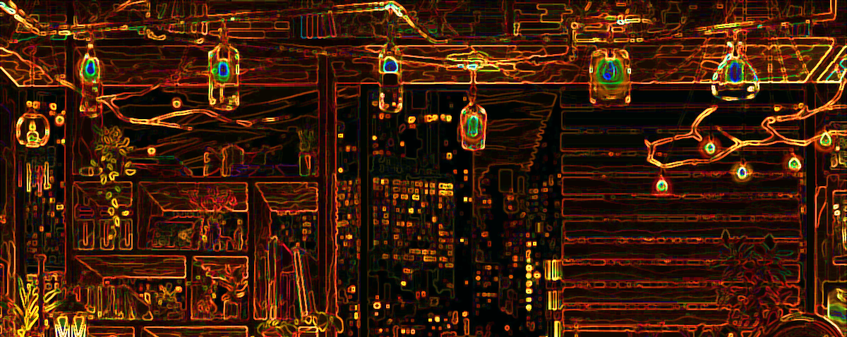
Cocorog piano*

Slide 3
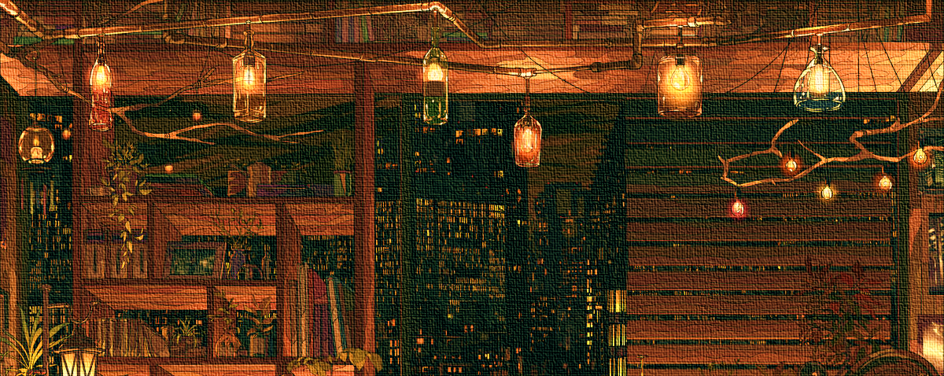
Cocorog piano*

